Slide 1


Understanding Customer Feedback – A Sentiment Analysis
Bhavya Pathak
MSc. Data Science
36604403

Slide 2

Introduction

Slide 3
Background
Company: Next plc a large clothing retailer
Problem statement:
With the rise of digital platforms and social media, customers have become more vocal about their experiences.
These feedbacks are usually free text
In this study we needed to analyse this text correctly to inform business strategies
Data: 732,621 customer interactions (comments, customer-rated survey scores, agent handling the interaction, etc.)

Slide 4
Objective
Develop an NLP model for sentiment analysis.
Align sentiments with customer ratings.
Provide actionable insights for enhancing customer service strategies.

Slide 5
Scope
Tailored for NEXT plc customer feedback analysis.
Primary data collected by NEXT.
Focused on identifying sentiments associated with specific aspects of the customer experience.
Does not cover other types of customer feedback analysis, such as the customer segmentation analysis.

Slide 6
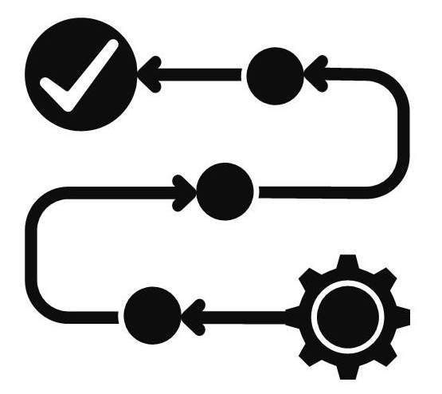
METHODOLOGY

Slide 7
Data Collection & Preprocessing
Data sources: Customer feedback from calls, surveys, and chats
Preprocessing:
Converting data types
Dropping irrelevant columns
Handling missing values
Text cleaning
Expanding abbreviations
Tokenization, removing stop words and lemmatization

Slide 8
Initial Models
Categories | BERT | LSTM
Full form | Bidirectional encoder representations from transformers | Long short-term memory networks
Architecture | Transformer | Recurrent neural network
Context handling | Bidirectional (both left and right) | Unidirectional (only left)
Training speed | Slow, requires high computational power and memory | Faster than BERT but still slow due to sequential processing
Memory usage | High | Moderate
Strength | Known for high accuracy in NLP tasks, including sentiment analysis. | Effective in handling long-term dependencies in sentences.

Slide 9
Finalized Model (1 of 2)
TEXTCNN
Purpose: Adapted from traditional CNNs to work with text data.
Architecture:
Embedding layer: Converts input text into dense vector representations using pre-trained embeddings.
Convolutional layers: Filters slide over the text to capture n-grams, detecting local dependencies between words.
Pooling layer: Max-pooling is used to reduce the dimensionality of the feature maps while preserving the most relevant features.
Fully connected layer: Synthesizes features and outputs the sentiment score through linear regression in this study.
Advantages: Computationally efficient and captures local patterns (i.e. effectively identifies key phrases and local interactions in the text)

Slide 10
Finalized Model (2 of 2)
GRADIENT BOOSTING
Purpose: Used as a benchmark model for sentiment prediction, offering a simpler, more interpretable alternative to deep learning models.
Steps:
Text preprocessing: Applied tokenization, stop word removal, TF-IDF to convert text into numeric feature set.
Model: Gradient Boosted Trees Regressor (GBTRegressor) was trained on the same dataset as for TextCNN.
Hyperparameters: 1000 boosting rounds, max depth of 3.
Evaluation: Done on same text dataset as TextCNN.
Predictions were compared using MAE and correlation with customer rating.
Advantages: Interpretable and fast to train

Slide 11

RESULTS

Slide 12
Model Comparison
BERT:
Accuracy: 8.4% (sample of 1000 records).
Training time: Took 70 minutes to process 1000 records, estimated to take 23 days for the full dataset.
LSTM:
Accuracy: 8.0% (sample of 1000 records).
Training time: Faster than BERT but still significant, estimated to take nearly 3 days to process the entire dataset.
TextCNN:
Accuracy: 80%
MAE: 0.35
Correlation with survey score: 0.73
Training time: 70 mins for full dataset.
Gradient Boosting:
MAE: 0.57
Correlation with survey score: 0.42
Training time: 50 mins for full dataset.

Slide 13
TextCNN Performance (1 of 2)
Predicted score distribution
Correlation matrix

Slide 14
TextCNN Performance (2 of 2)
Score difference distribution
Extreme misclassification

Slide 15
Actionable Insights
Common issues
High performers
Areas of excellence
Low performers

Slide 16

Conclusion

Slide 17
Recommendations AND FUTURE WORK
Recommendations:
Adopt TextCNN Model for large-scale sentiment analysis.
Refine customer rating system for clarity (e.g., 5-star scale).
Use insights for targeted agent/manager/department improvements.
Future Work:
Enhance sentiment analysis with advanced models
Sentiment analysis across different languages
Investigate the impact of sentiment on customer retention
Analyse factors leading to high and low performance

